Slide 1
Artificial Intelligence and Machine Learning
Project
CV Analysis
Team Details:
Nampreet Singh 2210990596
Narinder Singh 2210990598
Nikhil Dhiman 2210990609
Nipun Kumar 2210990615
Faculty Coordinator:
Shubham Singhal
:
Chitkara University Institute of Engineering and Technology,
Chitkara University, Punjab

Slide 2
Table of Contents
Introduction
Objective
Methodology, Approach & Techniques
Source Code
Result
Conclusion
References

Slide 3
Introduction
This project focuses on automating the categorization of resumes into different job categories using machine learning techniques.
With the increasing volume of resumes received for job openings, manual sorting becomes impractical. Automating this process can improve efficiency and reduce bias.
Automated resume categorization offers benefits such as faster recruitment, reduced bias, and insights into candidate pools, ultimately enhancing the hiring process's overall efficiency.

Slide 4
Objective
Automated Categorization:
Develop a machine learning model capable of automatically categorizing resumes into predefined job categories.
Streamline Recruitment Process:
Improve the efficiency of the recruitment process by reducing the time and effort required for manual resume screening.
Enhance Hiring Efficiency:
Enable recruiters to focus on evaluating candidate suitability by automating the initial resume sorting process, thereby enhancing overall hiring efficiency.

Slide 5
Problem Statement
Overwhelming Resume Volume:
Organizations receive a large volume of resumes for job openings, making manual sorting and categorization impractical and time-consuming.
Time-Consuming Manual Screening:
Manual screening of resumes by recruiters is tedious and inefficient, leading to delays in the hiring process and potential oversight of qualified candidates.
Need for Automation:
There is a pressing need to automate the resume categorization process to streamline recruitment, reduce human bias, and improve overall hiring efficiency.

Slide 6
Methodology, Approach & Algorithms
Methodology:-
Data Collection:
Gathered a dataset of resumes containing various job categories from diverse sources, ensuring representative samples for effective model training.
Data Preprocessing:
Cleaned the resumes by removing URLs, hashtags, mentions, punctuation, and other noise using regular expressions. Tokenized the text and removed stop words to prepare it for analysis.
Feature Extraction:
Utilized TF-IDF (Term Frequency-Inverse Document Frequency) vectorization to convert text data into numerical features, capturing the importance of words in each resume relative to the entire dataset.
Model Training:
Logistic Regression is used for binary classification, SVM for both binary and multiclass classification, and Decision Tree for classification tasks in your CV analysis project.
Evaluation:
Split the dataset into training and testing sets to evaluate the model's performance. Calculated accuracy metrics and generated a classification report to assess the model's effectiveness in categorizing resumes.

Slide 7
Methodology, Approach & Algorithms
Approach:-
Data Preprocessing:
Cleaned the resumes by removing noise and irrelevant information, such as URLs, hashtags, mentions, and punctuation. Tokenized the text and removed stopwords to prepare it for analysis.
Feature Extraction:
Utilized TF-IDF (Term Frequency-Inverse Document Frequency) vectorization to convert the textual data into numerical features, capturing the importance of words in each resume.
Model Training and Evaluation:
Selected the Logistic Regression classifier for its simplicity and effectiveness in handling text classification tasks. Trained the model on the preprocessed and feature-extracted data, evaluated its performance using accuracy metrics and classification reports.

Slide 8
Methodology, Approach & Algorithms
Algorithms:-
Logistic Regression: Logistic regression is a classification technique used to predict the probability of a binary outcome based on input features. It's simple, interpretable, and effective for tasks like spam detection and medical diagnosis.
SVM: Support Vector Machine (SVM) is a versatile machine learning algorithm used for classification and regression tasks. It finds the best hyperplane to separate different classes in high-dimensional data, making it effective for tasks like image classification and text categorization.
Decision Tree: Decision Tree is a versatile algorithm used for classification and regression tasks. It creates a tree-like structure of decisions based on input features, making it simple, interpretable, and effective for various applications.

Slide 9
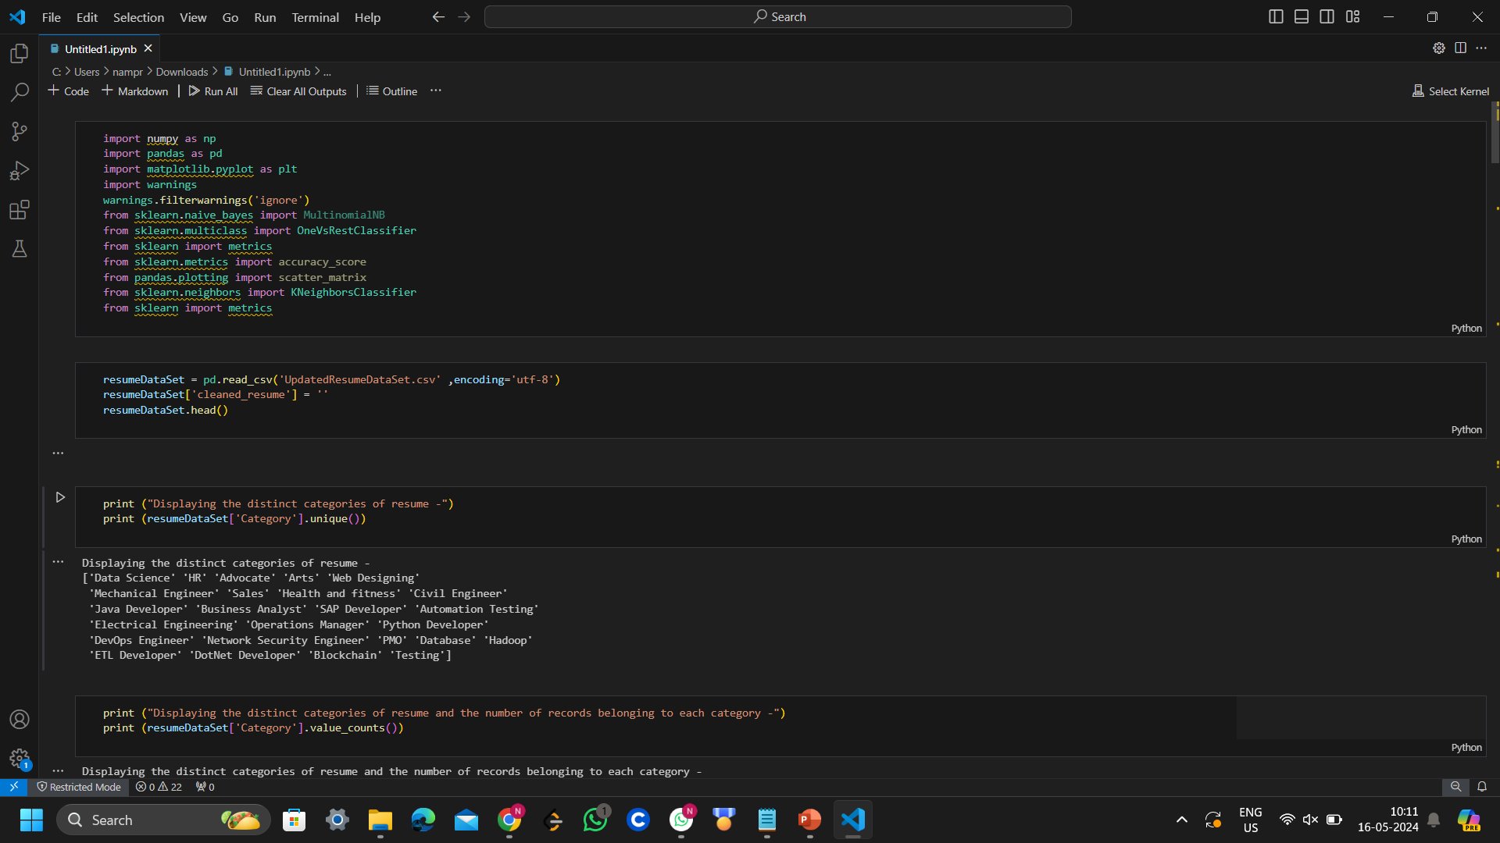
Source Code

Slide 10
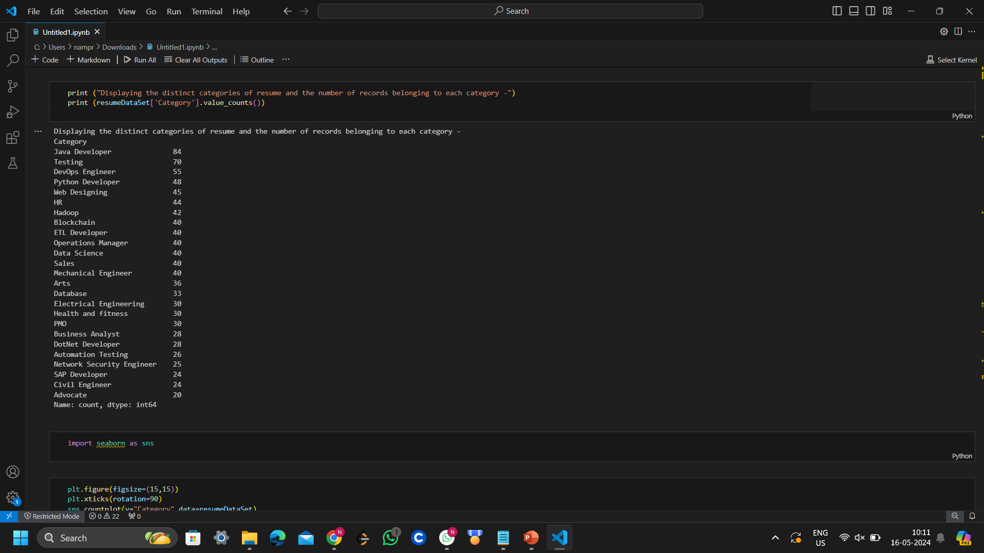
Source Code

Slide 11
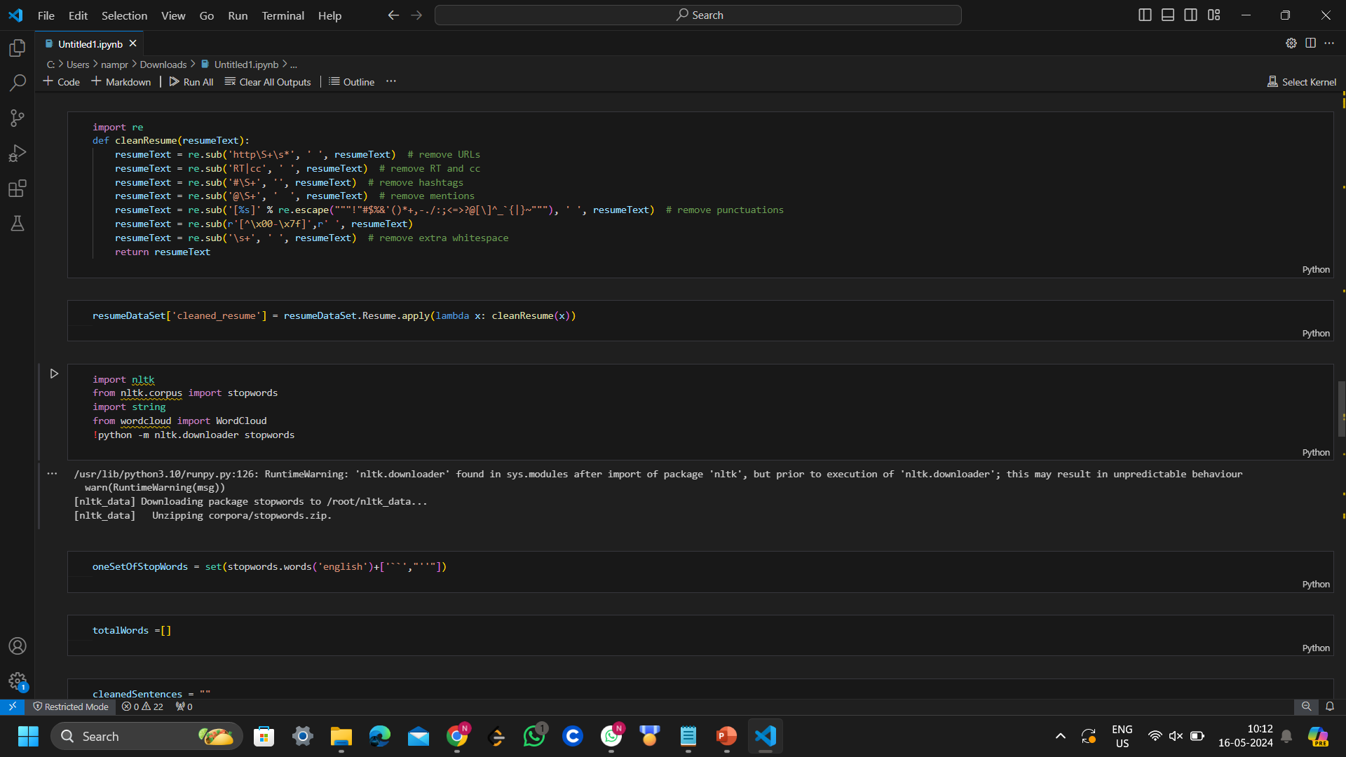
Source Code

Slide 12
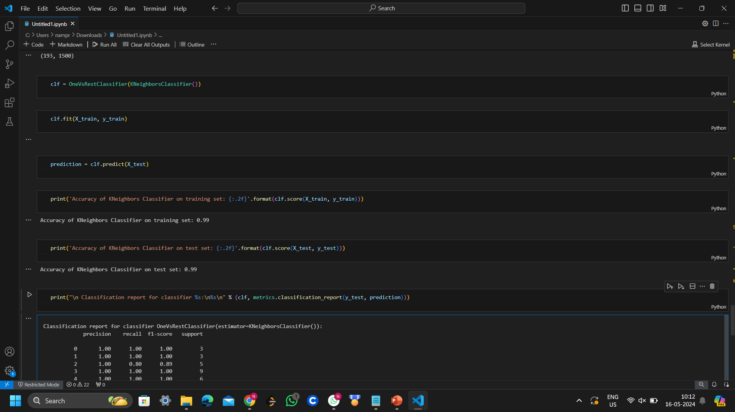
Source Code

Slide 13
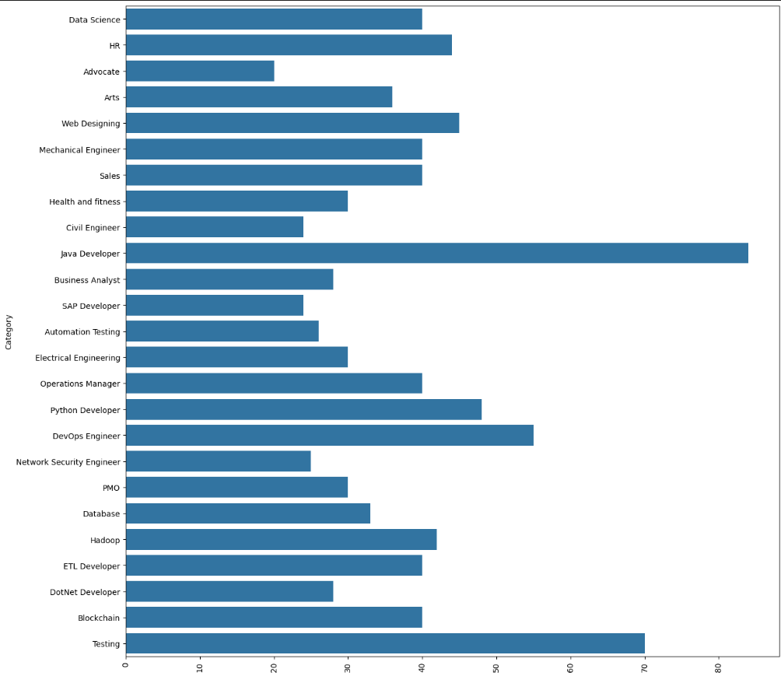
Result

Slide 14
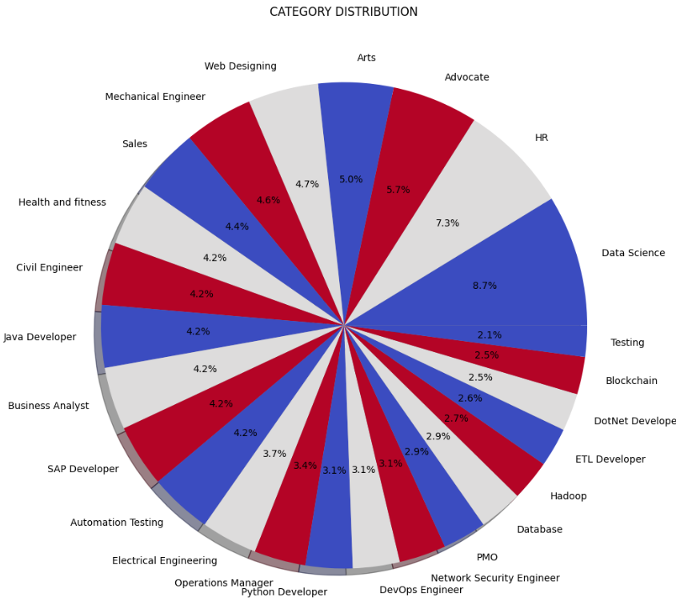
Result

Slide 15
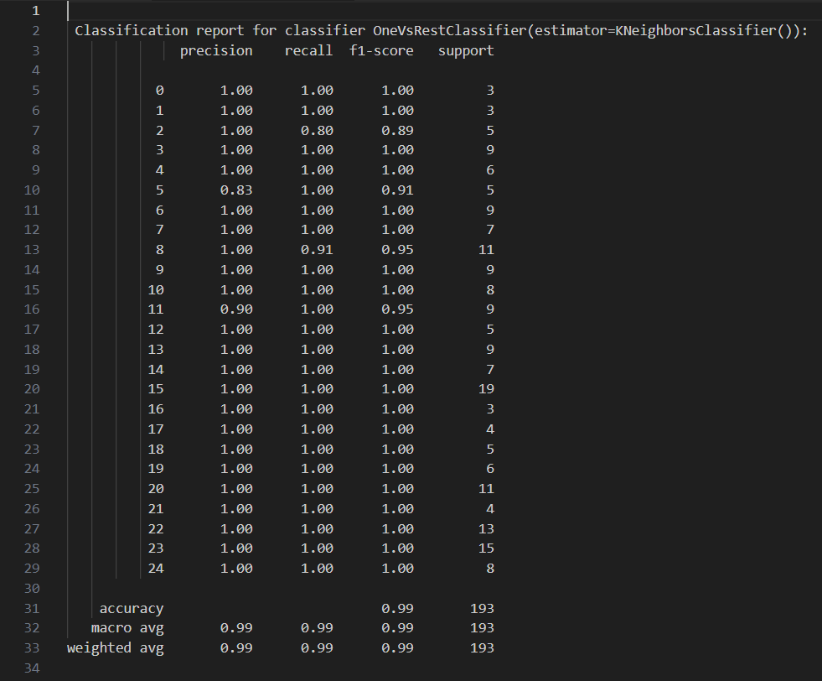
Result

Slide 16
Conclusion
In conclusion, the project successfully automated
resume categorization using the KNeighbors classifier.
While the model shows promising accuracy, further
optimization and evaluation are needed for enhanced
performance.
Overall, the project highlights the potential of machine
learning to streamline recruitment processes, offering
efficiency gains and improved decision-making.

Slide 17
References
The reference used are :
https://www.youtube.com
https://www.ijraset.com/research-paper/cv-analysis-using-machine-learning
https://www.kaggle.com/code/gauravduttakiit/resume-screening-using-machine-learning

Slide 18
The End

